Slide 1
2023-01-27

Slide 2
Unit 7 Review

Slide 3
7.1: ArrayList

Slide 4
ArrayList
ArrayLists are collections of values of the same Object type; But have different declaration syntax than Arrays; Primitive types (int, boolean, double, etc.) are not supported
ArrayList<type> name;
Examples
ArrayList<boolean> answers; ** PRIMITIVE TYPES UNSUPPORTED ** ArrayList<Boolean> answers; ArrayList<int> scores; ** PRIMITIVE TYPES UNSUPPORTED ** ArrayList<Integer> scores; ArrayList<String> questions; ArrayList<Student> students;
Important: You must import ArrayList prior to using it import java.util.ArrayList;

Slide 5
Generics / Generic Types
ArrayList is an example of a class that uses a Generic Type
ArrayList<type> name;
Generic Types are an option when the same code can be used across a variety of data types – and frees you from needing to create an overloaded method for every type
ArrayList is able to use Generic Types because the internals assume everything is a Object type (and all Object types share the functionality required for ArrayList to work)
You can read more about Generics in the online Java documentation
Oracle Java Documentation: Why Use Generics?

Slide 6
ArrayList
Like Arrays, you must initialize ArrayLists prior to using them; The most common usage is with the no-parameter Constructor ArrayList<Boolean> answers = new ArrayList<Boolean>(); ArrayList<Integer> scores = new ArrayList<Integer>(); ArrayList<String> questions = new ArrayList<String>(); ArrayList<Student> students = new ArrayList<Student>();
Note: There are two other ArrayList Constructors that you can explore on your own ArrayList<type> name = new ArrayList<type>(Collection<type> c); ArrayList<type> name = new ArrayList<type>(init initialCapacity);

Slide 7
ArrayList
Unlike Arrays, ArrayLists automatically manage their memory usage as you ArrayList.add() and ArrayList.remove() elements to/from the the ArrayList
Unlike Arrays, ArrayLists do not have a length property that indicates the fixed-size of the Array; They have the ArrayList.size() method that indicates the current number of elements included in the ArrayList
ArrayLists have an internal capacity - which you cannot access - that grows and shrinks as needed to ensure elements can be quickly added. The default capacity is 10.
The capacity is adjusted to ensure that the there is enough free space to quickly accommodate new items via ArrayList.add(); But not so much excess free space that available memory is wasted

Slide 8
Array vs ArrayList
Array
true
false
true
false
false
false
false
false
false
false
0
1
2
3
4
5
6
7
8
9
boolean[] answers = new boolean[10]; answers[0] = true; answers[1] = false; answers[2] = true; answers.length == 10 answers[3-9] are set to default values
ArrayList
true
false
true
0
1
2
3
4
5
6
7
8
9
ArrayList<Boolean> answers = new ArrayList<Boolean>(); answers.add(true); answers.add(false); answers.add(true); answers.size() == 3 answers[3-9] are unused pre-allocated capacity

Slide 9
ArrayList Methods

Slide 10
ArrayList Methods
Signatures
boolean add(E obj)
void add(int index, E obj)
Overview
Add an item either to the end of the ArrayList (always returns true) or at the specified index (existing items will shift right; their index values will increase by 1)
The first version of add() always returns true because ArrayList implements the Collection interface - which can be implemented by other classes to restrict the creation of duplicate or null elements (ArrayList has no such restrictions)
Automatically increases the ArrayList capacity as needed
Will throw IndexOutOfBoundsException if index is out of range (index < 0 || index > size())
add()
clear()
get()
isEmpty()
remove()
removeRange()
set()
size()
ArrayList index values are zero-based (just like Arrays)

Slide 11
ArrayList Methods
add()
clear()
get()
isEmpty()
remove()
removeRange()
set()
size()
Signatures
void clear()
Overview
Removes all elements from the ArrayList
After this call ArrayList.size() == 0
Automatically decreases the ArrayList capacity as needed

Slide 12
ArrayList Methods
add()
clear()
get()
isEmpty()
remove()
removeRange()
set()
size()
Signatures
E get(int index)
Overview
Returns the element at the specified position in the ArrayList
You must use this method to access the items in an ArrayList; ArrayList does not support the [] syntax of Arrays
Will throw IndexOutOfBoundsException if index is out of range (index < 0 || index >= size())
ArrayList index values are zero-based (just like Arrays)

Slide 13
ArrayList Methods
add()
clear()
get()
isEmpty()
remove()
removeRange()
set()
size()
Signatures
boolean isEmpty()
Overview
Returns true if the ArrayList has no items

Slide 14
ArrayList Methods
Signatures
boolean remove(Object obj)
E remove(int index)
Overview
Removes the first item from the ArrayList that matches obj; or at the specified index (existing items will shift left; their index values will decrease by 1)
remove(Object obj) returns true/false if an element in the ArrayList returns true for obj.equals(element) (or obj == null == element) and was removed
Note: Does not use Object equality (obj == element)
remove(int index) returns the element that was removed from the ArrayList
Automatically decreases the ArrayList capacity as needed
Will throw IndexOutOfBoundsException if index is out of range (index < 0 || index >= size())
add()
clear()
get()
isEmpty()
remove()
removeRange()
set()
size()
ArrayList index values are zero-based (just like Arrays)

Slide 15
ArrayList Methods
add()
clear()
get()
isEmpty()
remove()
removeRange()
set()
size()
Signatures
void removeRange(int fromIndex, int toIndex)
Overview
Removes all of the elements whose index is between fromIndex (inclusive) and toIndex (exclusive). Shifts any succeeding elements to the left (reduces their index).
Automatically decreases the ArrayList capacity as needed
Will throw IndexOutOfBoundsException if fromIndex or toIndex is out of range (fromIndex < 0 || fromIndex >= size() || toIndex > size() || toIndex < fromIndex)
ArrayList index values are zero-based (just like Arrays)

Slide 16
ArrayList Methods
add()
clear()
get()
isEmpty()
remove()
removeRange()
set()
size()
Signatures
E set(int index, E element)
Overview
Replaces the element at the specified position in this ArrayList with the specified element.
Returns the element that was removed from the ArrayList at index
You must use this method to access the items in an ArrayList; ArrayList does not support the [] syntax of Arrays
Will throw IndexOutOfBoundsException if index is out of range (index < 0 || index >= size())
ArrayList index values are zero-based (just like Arrays)

Slide 17
ArrayList Methods
add()
clear()
get()
isEmpty()
remove()
removeRange()
set()
size()
Signatures
int size()
Overview
Returns the number of elements in this ArrayList

Slide 18
7.3: Traversing ArrayLists with Loops

Slide 19
Traversing ArrayLists
ArrayLists support the same mechanisms you used when traversing Arrays - while, for, for-each - with the following differences
Operation | Array | ArrayList
length/size | Array.length (property) | ArrayList.size() (method)
read | value = array[index]; | value = arrayList.get(index);
write | array[index] = value; | arrayList.set(index, value);

Slide 20
Traversing ArrayLists
Array - for loop
Integer[] array = {1, 2, 3, 4, 5}; for (int idx = 0 ; idx < array.length ; idx++) { int value = array[idx]; System.out.println(value); array[idx] = value + 1; }
ArrayList - for loop
Integer[] array = {1, 2, 3, 4, 5}; ArrayList<Integer> arrayList = new ArrayList<Integer>(Arrays.asList(array)); for (int idx = 0 ; idx < arrayList.size() ; idx++) { int value = arrayList.get(idx); System.out.println(value); arrayList.set(idx, value + 1); }

Slide 21
Traversing ArrayLists
Array & ArrayList - for loop ArrayIndexOutOfBoundsException
This exception will be thrown if you try to access the item at an index less than 0 or greater than the number of items in the Array or ArrayList

Slide 22
Traversing ArrayLists
Array - for-each loop
Integer[] array = {1, 2, 3, 4, 5}; for (Integer value : array) { System.out.println(value); }
ArrayList - for-each loop
Integer[] array = {1, 2, 3, 4, 5}; ArrayList<Integer> arrayList = new ArrayList<Integer>(Arrays.asList(array)); for (Integer value : arrayList) { System.out.println(value); }

Slide 23
Traversing ArrayLists
ArrayList for-each loop ConcurrentModificationException
This exception will be thrown if you try to add or remove items from an ArrayList while traversing that ArrayList with a for-each loop

Slide 24
7.5
Search Algorithms

Slide 25
Sequential Search (aka Linear Search)
for i ← 0 to length(array)-1 if array[i] == targetValue return i end if end for return not found
Pro: You can search for an item in any unsorted list and it is guaranteed to be found if it exists in the array
Con: If you’re searching a long list, this can be a very slow approach

Slide 26
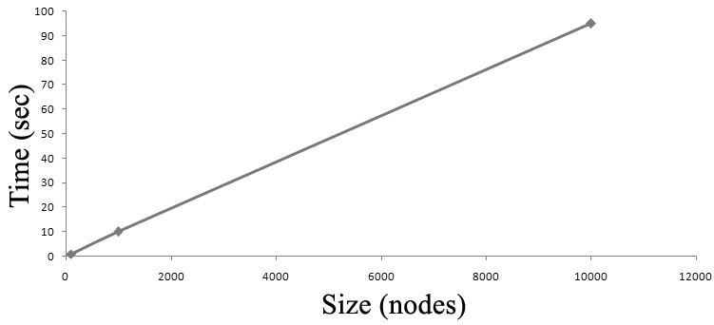
Sequential Search
If your list contains N elements, and the target element is at a random position in the list then on average it will take N/2 checks to find your element. When the time an algorithm takes to complete is directly related to the size of the array (N), we call this algorithm linear and the notation is O(N).

Slide 27
Binary Search: Divide and Conquer
Binary search is a much faster algorithm, but requires that the list be sorted.
We can use the fact that the list is sorted to reduce the problem to smaller problems.
An algorithm that breaks the problem into smaller sub-problems is called a divide-and-conquer algorithm.
1
3
6
7
9
12
13
16

Slide 28
Binary Search Algorithm
Let's run through it on the whiteboard...
// Precondition: array must be in sorted order low ← 0, high ← length(array)-1 while low <= high middle ← (low + high) / 2 if array[middle] == targetValue return middle else if array[middle] < targetValue low ← middle + 1 else high ← middle - 1 end if end while return not found

Slide 29
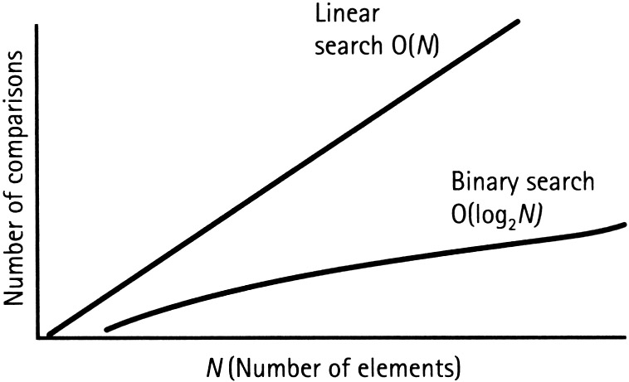
Binary Search
If your list contains N elements, and the target element is at a random position in the list then on average it will take log₂N checks to find your element. To give you a sense of this speedup, the log₂1024 = 10 (since 2¹⁰ = 1024). This means that binary search runs 10x faster on sorted lists of length ~1K. The notation for this algorithm is O(log N)

Slide 30
Comparing Sequential Search vs Binary Search (These are "worst case" numbers.)
N | Sequential Search Comparison Count | Binary Search Comparison Count
2 | 2 | 2
4 | 4 | 3
8 | 8 | 4
16 | 16 | 5
100 | 100 | 7

Slide 31
7.6.1
Selection Sort

Slide 32
Preconditions, Postconditions, and Invariants
We learned about these already:
A precondition to a method must be true before entering the method.
A postcondition to a method must be true when leaving the method.
An invariant is some condition that must always be true.
Example: In the class StudentDirectory, the data in the ArrayList "students" is always in sorted order by name.
Preconditions, postconditions, and invariants are used to formally prove the correctness of algorithms.

Slide 33
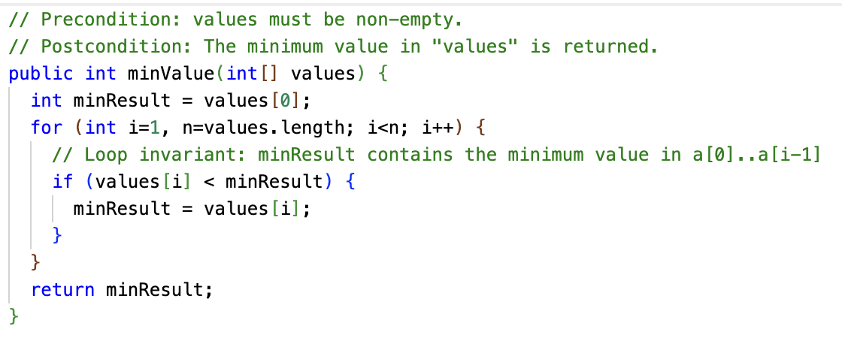
Loop Invariants
A loop invariant is a condition that must be true at the beginning and end of the body of a loop. (It might not be true while the loop body is doing its work, like swaps.)

Slide 34
Selection Sort
Selection Sort is an algorithm that relies on swapping array elements.
We used swapping in section 6.4 to reverse the elements in an array.
Java doesn't have a built-in "swap" capability, so you must use a temporary variable:
Swapping variables is also called exchanging variables. Sort algorithms that rely on swapping/exchanging values are classified as exchange sorts. (Confusingly, there is also a specific sort algorithm called Exchange Sort.)
// Swap array elements array[i] and array[j]
int temp = array[i];
array[i] = array[j];
array[j] = temp;

Slide 35
Selection Sort Algorithm
Let's run through it on the whiteboard...
for i ← 0 to length(array)-1 // Loop invariant: The array to the left of i contains the i smallest values // in the array, in sorted order. jMin ← i for j ← i+1 to length(array)-1 // Loop invariant: A[jMin] is smallest value in range A[i]...A[j-1] if A[j] < A[jMin] then jMin ← j end for if jMin != i then swap A[i], A[jMin] end for

Slide 36
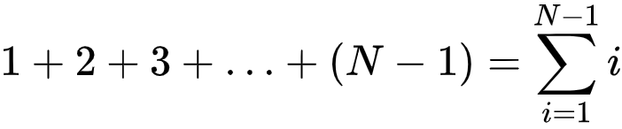
Selection Sort – an intuitive but slow algorithm
Loop # | Comparisons (N=8)
1 | 7
2 | 6
3 | 5
4 | 4
5 | 3
6 | 2
7 | 1
How many comparisons does Selection Sort do?
It does N-1 comparisons on the first pass, N-2 comparisons on the second pass, N-3 comparisons on the third pass, and so on.

Slide 37
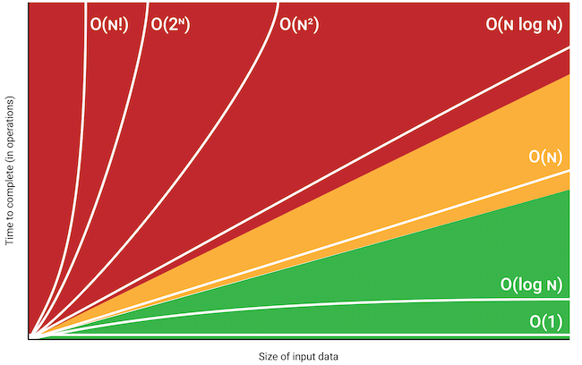
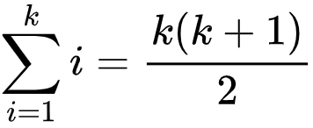
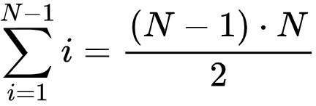
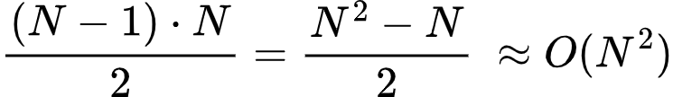
Selection Sort – our old friend O(N²)

Slide 38
Selection Sort – an intuitive but slow algorithm
O(N²) is also known as quadratic time. Many simple sort algorithms are quadratic time.
It can be OK for a small number of elements, but as N gets big, the algorithm's running time becomes very long.
In Unit 10, we will learn a sorting algorithm, merge sort, that has much better running time: O(N log N). But it's also more complicated to code!
N | N²
1 | 1
10 | 100
100 | 10,000
1000 | 1,000,000
10000 | 100,000,000
100000 | 10,000,000,000
1000000 | 10¹²

Slide 39
Selection Sort
Best case: Does (N²-N)/2 comparisons, 0 swaps
Worst case: Does (N²-N)/2 comparisons, N swaps
Average case: Does (N²-N)/2 comparisons, N/2 swaps

Slide 40
7.6.2
Insertion Sort

Slide 41
Introducing Insertion Sort
Insertion Sort is more complex than Selection Sort, but is much faster when the data is partially sorted.
Insertion Sort is still a quadratic algorithm, that is, O(N²).
Insertion Sort is faster in practice than other quadratic algorithms such as Selection Sort.
Insertion Sort is actually one of the fastest known algorithms for sorting very small arrays. (Around <=10 items.)

Slide 42
Insertion Sort Algorithm
Insertion Sort has a loop invariant that for index i, the entire sub-array to the left of i is in sorted order.
This is slightly different from Selection Sort's loop invariant... how?
Insertion Sort's outer loop starts with i = 1, that is, pointing to the second element in the array.
Why? The sub-array to the left of i = 1, a[0..0], is in sorted order, because a one-element array is always in sorted order!

Slide 43
Insertion Sort Algorithm
Let's run through it on the whiteboard...
// Note we start with second element i = 1 for i ← 1 to length(array)-1 // Loop invariant: The array to the left of i is a sorted sub-array. // j will represent the insertion point of the value. j ← i while j > 0 and A[j-1] > A[j] // As we scan for insertion point, we swap the element // we are inserting (which will move to the left) with the // element to its left. swap A[j], A[j-1] j ← j - 1 end while end for

Slide 44
Insertion Sort Algorithm: Swapless Edition
// A bit more efficient than swapping. Less read/write operations. // Note we start with second element i = 1 for i ← 1 to length(array)-1 // Loop invariant: The array to the left of i is a sorted sub-array. // Save the value at A[i], as it may be overwritten x ← A[i] // j will represent the insertion point of the value. j ← i while j > 0 and A[j-1] > x // As we scan for insertion point, we move elements // to the right. A[j] ← A[j-1] j ← j - 1 end while // Finally, write the element being inserted into its final spot. A[j] ← x end for

Slide 45
Insertion Sort
Best case: an already sorted array
(Does well on partially sorted arrays too)
Worst case: an entirely reversed array
Average case: about half the comparisons of Selection Sort

